Slide 1
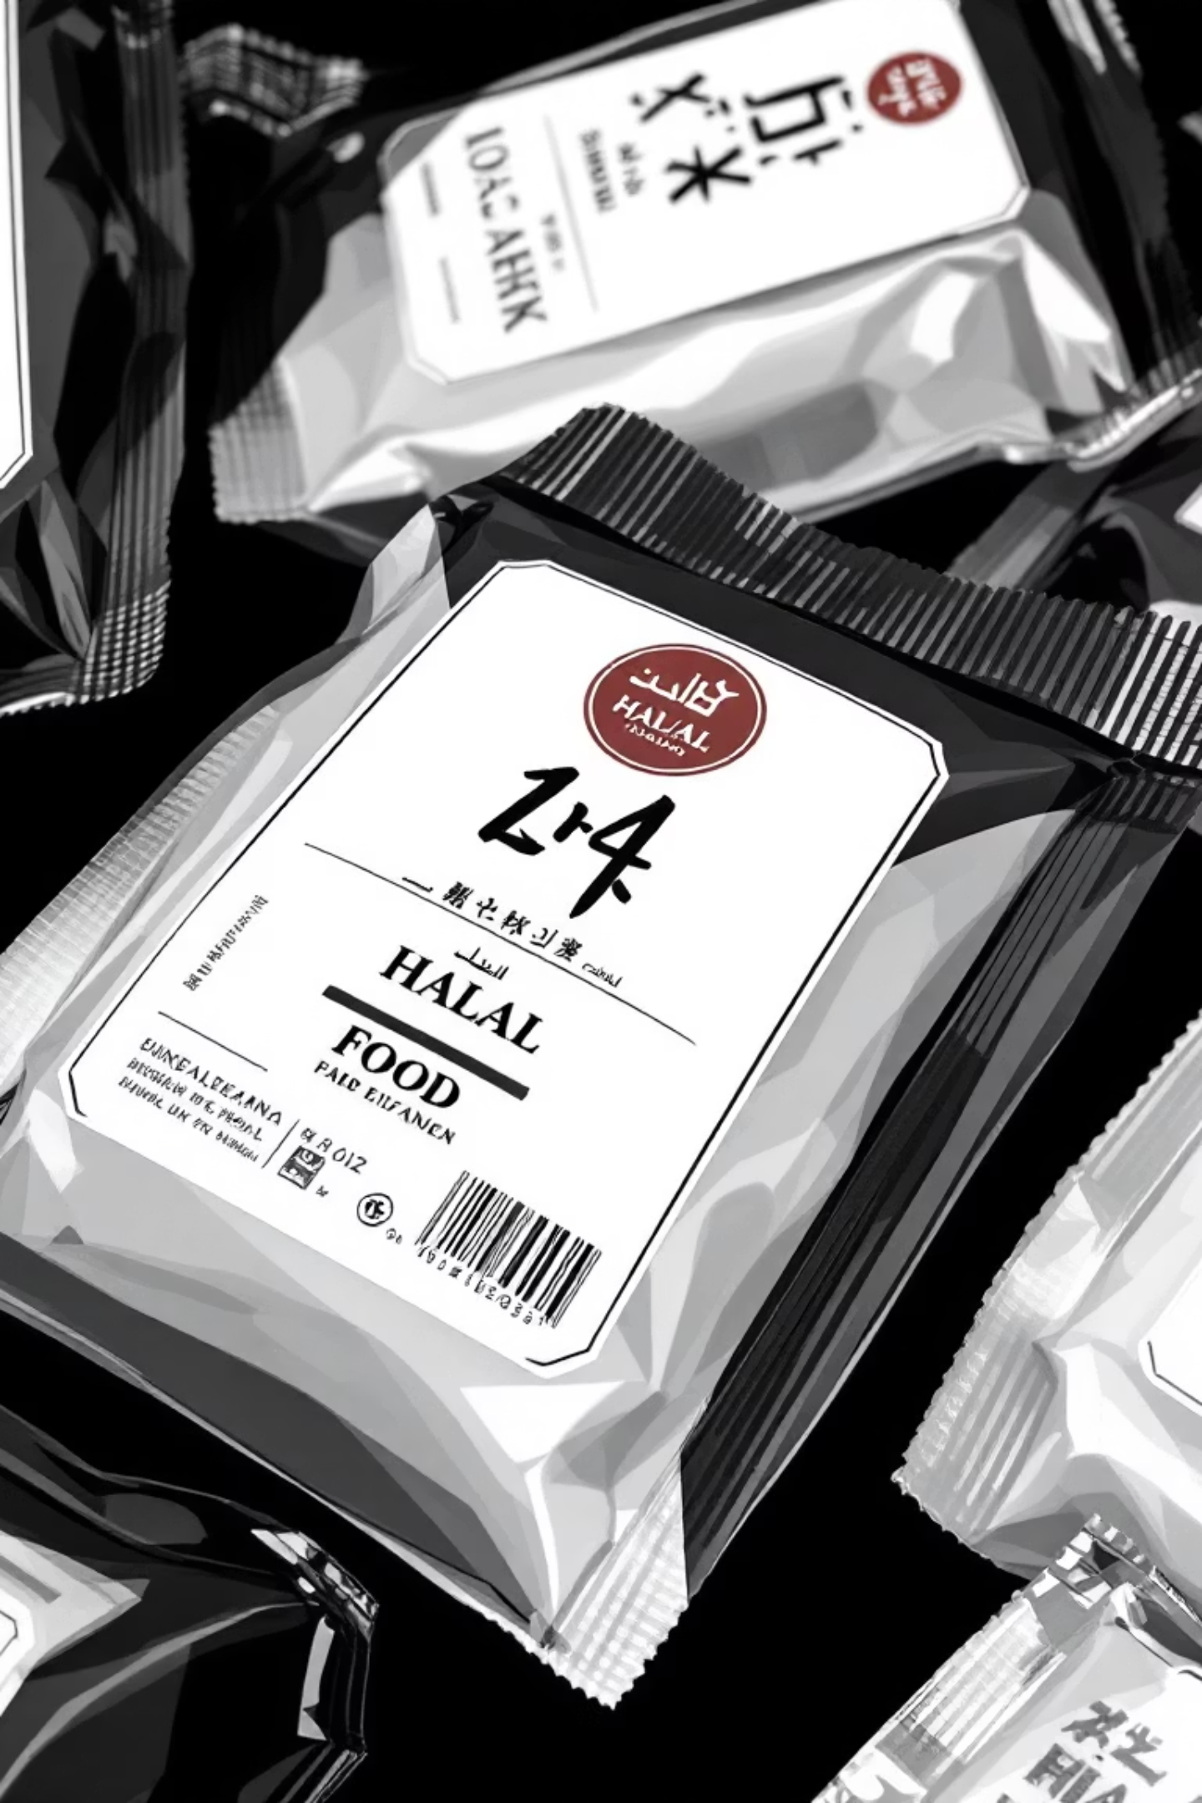
Halal Logo & Barcode Detection System
A Computer Vision Application for Automated Halal Certification & Barcode Recognition.
Name | Enrollment
Muzammil Amjad | 03-134212-080
Asad Ali | 03-134202-013
Nazar Ali | 03-134221-033

Slide 2




Project Overview: Ensuring Halal Compliance
This system combines computer vision, barcode recognition, and machine learning to automatically verify the halal status of food products, ensuring compliance and consumer confidence.
Halal Logo Detection
Barcode Scanning & Decoding
UtelizingYOLOv8 for real-time identification of halal certification symbols.
Recognising and decoding various barcode formats (EAN-13, UPC-A, QR codes, etc.) using pyzbar.
Ingredient OCR Extraction
Ingredient Classification
Extracting ingredient lists from product images with PyTessaract for detailed analysis.
Employing a trained ML classifier to categorise ingredients as Halal, Haram, or Suspicious.

Slide 3

Academic Context & Core Demonstrations
Developed as part of the Computer Vision & Computer Pattern Recognition (CCP) course at Bahria University (2024-2025), this project showcases advanced technical skills.
Deep Learning Fundamentals
Application of YOLOv8 architecture for robust object detection.
Computer Vision Techniques
Expertise in image preprocessing, annotation, and multi-model inference.
Machine Learning Pipeline
Comprehensive approach from dataset preparation to model deployment.
Software Engineering
Adherence to clean code, modular design, and version control best practices.

Slide 4
Features: Comprehensive Halal Verification
Our system provides a robust suite of features designed for thorough halal food product analysis.
Product Information Lookup
Multi-Input Support
Fetching product details via OpenFoodFacts API using decoded barcodes.
Three independent workflows: image scanner, OCR classifier, and manual input.
Halal/Haram Verdict
Interactive Streamlit Interface
Generating an overall halal status based on all available evidence.
A user-friendly, tab-based UI with real-time processing and visual feedback.

Slide 5

System Architecture: A Unified Approach
The architecture integrates a Streamlit web interface with advanced CV and ML models, ensuring seamless data flow and
comprehensive analysis.
Streamlit Web Interface
Image Input Sources
Detection & Decoding
Annotation & Display

Slide 6

Installation & Setup: Get Started
Setting up the Halal Verification System is straightforward, requiring Python 3.8+, pip, Git, and libzbar.
Follow these steps to get the system up and running on your local machine.
Clone Repository: Obtain the project files from GitHub.
Create Virtual Environment: Ensure a clean and isolated development environment.
Install Dependencies: Use pip to install all required Python libraries.
Install Native Libraries: Set up Tesseract OCR and ZBar library for full functionality.
Verify Installation: Confirm all core dependencies are correctly installed.
Download & Extract Dataset (Optional): Prepare the training dataset for model experimentation.

Slide 7
Technical Specifications: Powering the System
Our system relies on cutting-edge models and components to deliver accurate and efficient halal verification.
YOLOv8 Object Detection
Utilises a CNN architecture for high-precision halal logo and barcode localisation.
Ingredient Classification Model
A Scikit-learn classifier providing Halal, Haram, or Suspicious verdicts on ingredients.
Barcode Decoding
Leverages pyzbar for multi-format barcode value extraction.
OCR (Optical Character Recognition)
Pytesseract extracts ingredient text from product labels, supporting multiple languages.

Slide 8
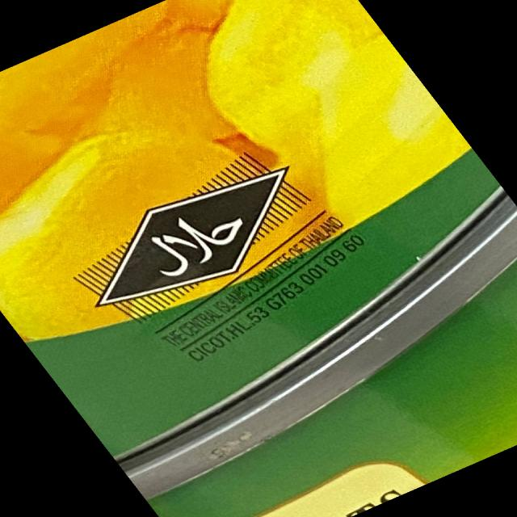
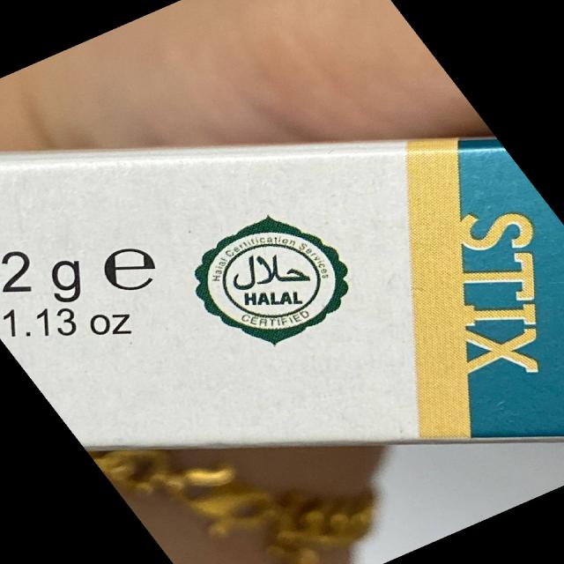
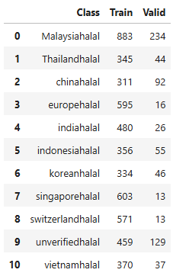
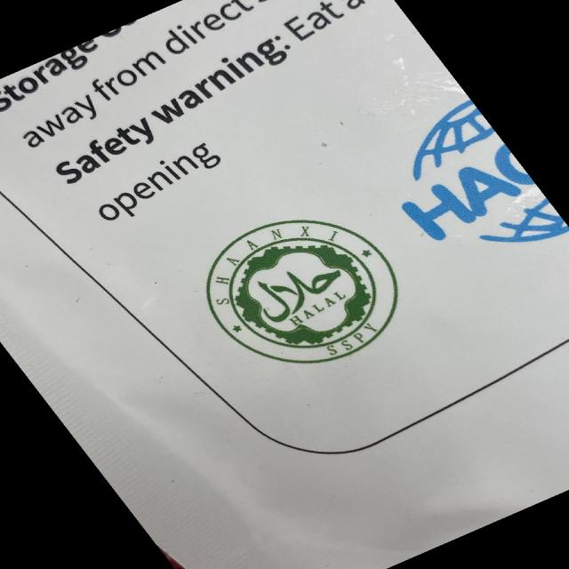
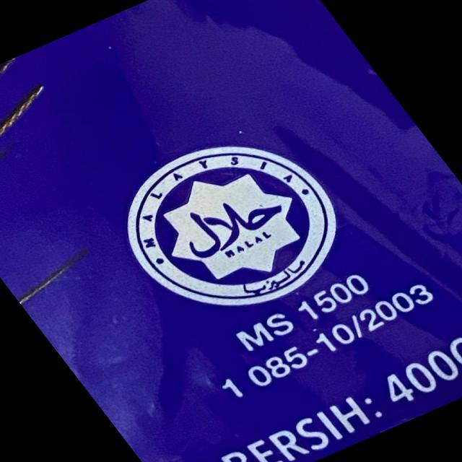
Dataset Information: Training & Validation
The system's intelligence is built upon carefully curated datasets, enabling accurate detection and classification.
Halal Logo Dataset (Roboflow)
Source: Roboflow, in YOLOv8 format.
Classes: Focuses on various halal certification logos.
Annotations: Normalised bounding box coordinates for precise detection.
This dataset ensures 11 Countries logo and the YOLOv8 model is well-trained
for logo recognition.
Ingredient Halal/Haram Dataset
Source: ingredient_haram_analysis.csv.
Format: CSV with ingredient names and their classifications.
Training: Used to train the halal_haram_classifier.pkl (Scikit-learn model).
Classes: Halal (0), Haram (1)
This dataset is crucial for the ML model's ability to categorise ingredients reliably.

Slide 9
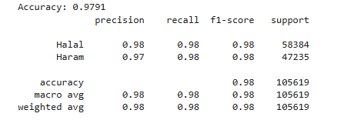
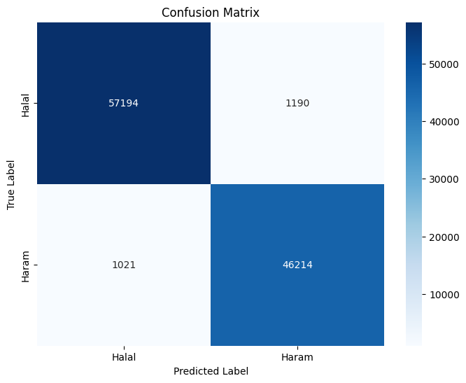
Model Training & Results
For Ingredients we usec Linear SVC. Linear SVC is chosen because it is
efficient, interpretable, and effective for high-dimensional sparse text
data, with ngram_range=(1,3), analyzer=char_wb TFidfVectorizer binary classification of halal vs haram ingredients in a large dataset.
Halal Logo Dataset (Roboflow)
Source: Roboflow, in YOLOv8 format.
Classes: Focuses on various halal certification logos.
Annotations: Normalised bounding box coordinates for precise detection.
This dataset ensures 11 Countries logo and the YOLOv8 model is well-trained
for logo recognition.
Ingredients Halal Haram Label (Kaggle)
From the class counts: Halal: 291,920
Haram: 236,172
Total = 291,920 + 236,172 = 528,092 entries.
TTS : 80% Train and 20% Test

